Slide 1


Spatially constrained Bayesian inversion of frequency-
and time-domain Airborne ElectroMagnetic data from the Tellus project
Duygu Kiyan¹, Volker Rath¹, and Robert Delhaye¹
¹School of Cosmic Physics, Geophysics Section, Dublin Institute for Advanced Studies, Dublin, Ireland
28 April, 2017

Slide 2
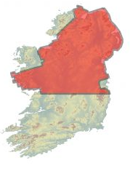
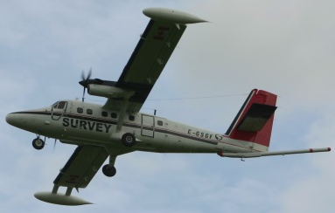
Tellus Project – Airborne Geophysics Component
The airborne geophysical survey comprises measurements of magnetic field, radiometrics and electrical conductivity of the near-surface.
The data will inform the management of
Ireland’s natural and environment resources.
The data are used to:
update and improve geological maps
improve radon risk mapping
map groundwater systems, e.g., identifying
groundwater pathways in the subsurface
AEMPY is a python toolbox developed for inversion of frequency- and time-domain airborne electromagnetic data of the TELLUS Surveys.
Figure courtesy: Geological Survey of Ireland

Slide 3
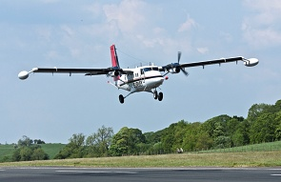
AEMPY Workflow
Conversion to Internal Data Format
FDEM Format
XUTM, YUTM, GPS, RADAR, IP912-24510, Q912-24510, PWLM
TDEM Format
XUTM, YUTM, GPS, RADAR, X1-X11, Z1-Z11
Define Dataset
Flight-line, polygon, profile projection
Input File
Tellus
FDEM & TDEM Data
Inversion Along Flight Line
Deterministic Approach
Tikhonov-type inversion
MAP inversion
Truncated SVD Inversion
Stochastic Approach
Markov Chain Monte Carlo
Pre-Processing
- Flag negative values and high-fly areas
- Interpolate
- Average/Block Data over a Number of
Stations
- PCA filtering

Slide 4
Spatially constrained Bayesian inversion of frequency-
and time-domain Airborne ElectroMagnetic data from the Tellus project
Duygu Kiyan¹, Volker Rath¹, and Robert Delhaye¹
¹School of Cosmic Physics, Geophysics Section, Dublin Institute for Advanced Studies, Dublin, Ireland
28 April, 2017

Slide 5
The Tellus Project – Airborne Geophysics Component
The airborne geophysical survey comprises of measurements of magnetic field, radiometrics and electrical conductivity of the near-surface.
The data will inform the management of
Ireland’s natural and environment resources.
The data are used to:
update and improve geological maps
improve radon risk mapping
map groundwater systems, e.g., identifying
groundwater pathways in the subsurface
AEMPY is a python toolbox developed for inversion of frequency- and time-domain airborne electromagnetic data of the TELLUS Surveys.
Figure courtesy: Geological Survey of Ireland

Slide 6
What is AEMPY?
AEMPY is a python toolbox developed for inversion of frequency- and time-domain airborne electromagnetic data of the TELLUS Surveys
Python & Fortran90
CSIRO/Amira forward codes
Modules and Scripts
Numpy, Scipy, Matplotlib
DIAS GIT Repository
Free Access
IMPLEMENTATION

Slide 7
AEMPY Workflow
Conversion to Internal Data Format
FDEM Format
XUTM, YUTM, GPS, RADAR, IP912-24510, Q912-24510, PWLM
TDEM Format
XUTM, YUTM, GPS, RADAR, X1-X11, Z1-Z11
Define Dataset
Flight-line, polygon, profile projection
Input File
Tellus FDEM & TDEM Data
Inversion Along Flight Line
Deterministic Approach
Tikhonov-type inversion
MAP inversion
Truncated SVD Inversion
Stochastic Approach
Markov Chain Monte Carlo
Pre-Processing
- Flag negative values and high-fly areas
- Interpolate
- Average/Block Data over a Number of
Stations
- PCA filtering

Slide 8
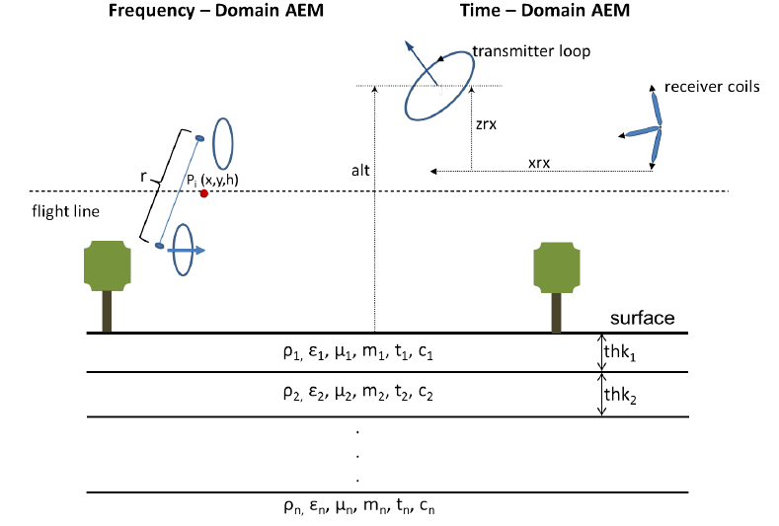
Tellus Project Airborne EM systems
Frequency-Domain AEM:
Instrument: JAC Airborne System - AEM05
Aircraft: De Havilland DHC-6 twin Otter (C-GSGF)
Flight Line spacing: 200m
Tie Line spacing: 2000m
Nominal Flight height: 59m (in rural areas)
240m (in urban areas)
Time-Domain AEM:
Instrument: TEM-GENESIS System
Aircraft: Cessna 208B (VH-ZKG and VH-ZKB)
Flight Line spacing: 200m
Tie Line spacing: 2000m
Nominal Flight height: 90m (in rural areas)
240m (in urban areas)

Slide 9
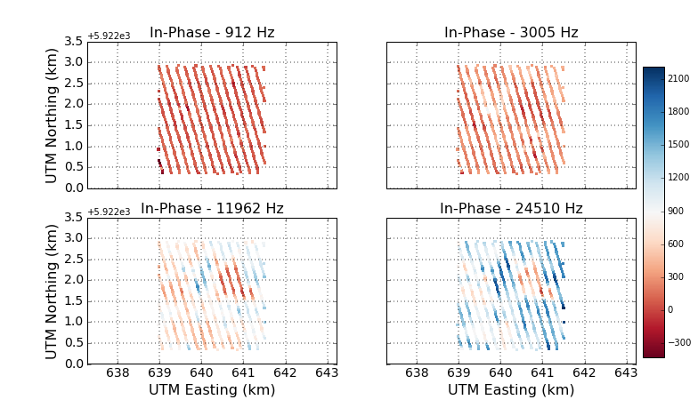
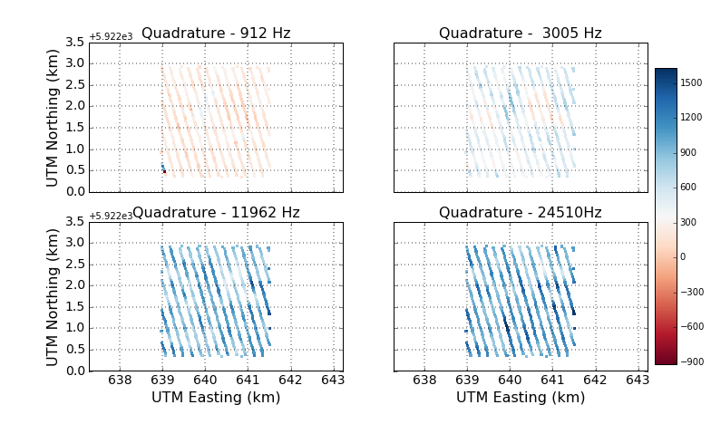
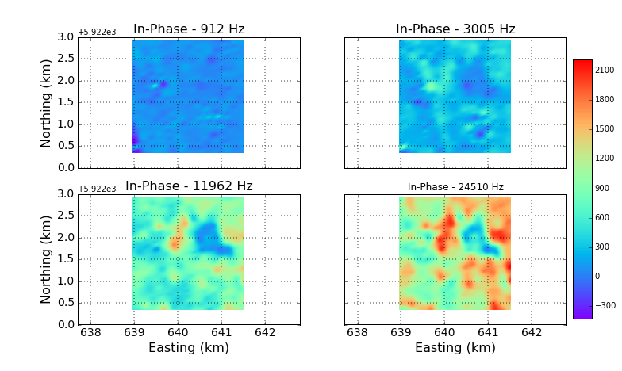
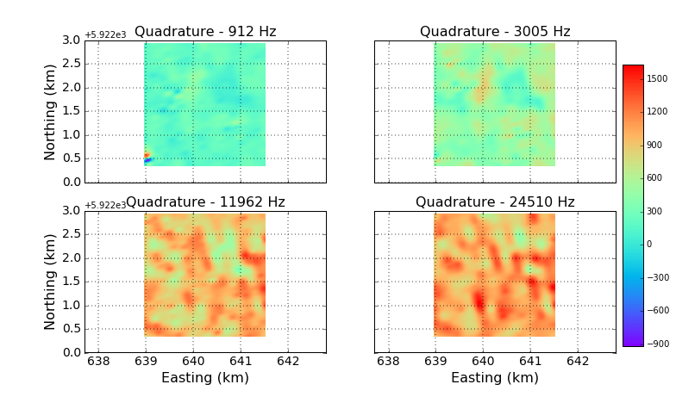
Data Visualisation
Scatter Plots
Interpolation Plots

Slide 10
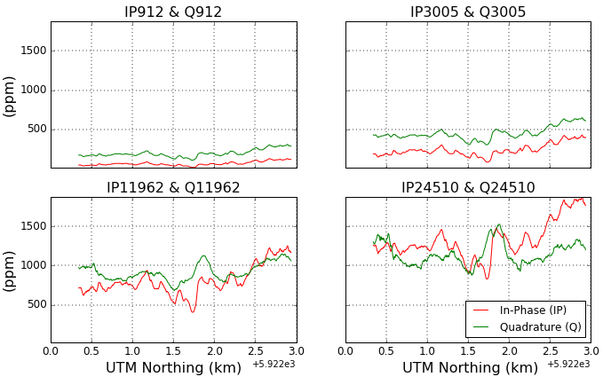
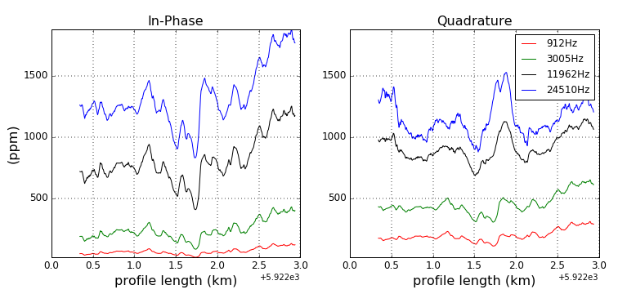
Data Visualisation
Along Flight-Lines
Plots
Notes:
Fumarole area – 200m depth 200 degrees.

Slide 11
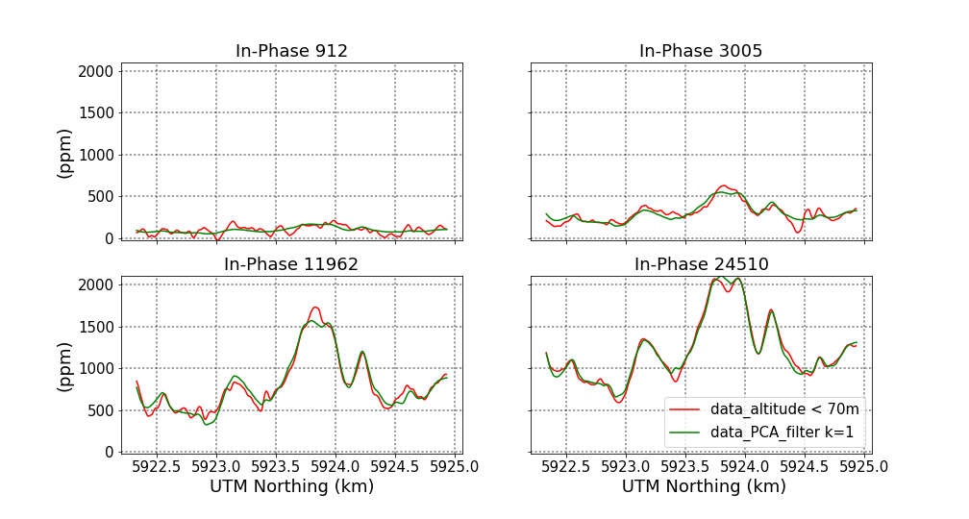
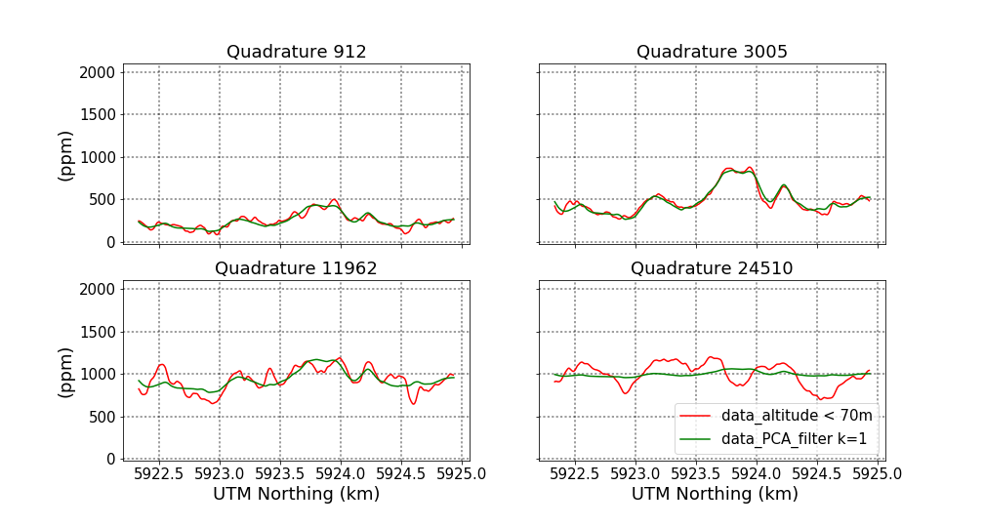
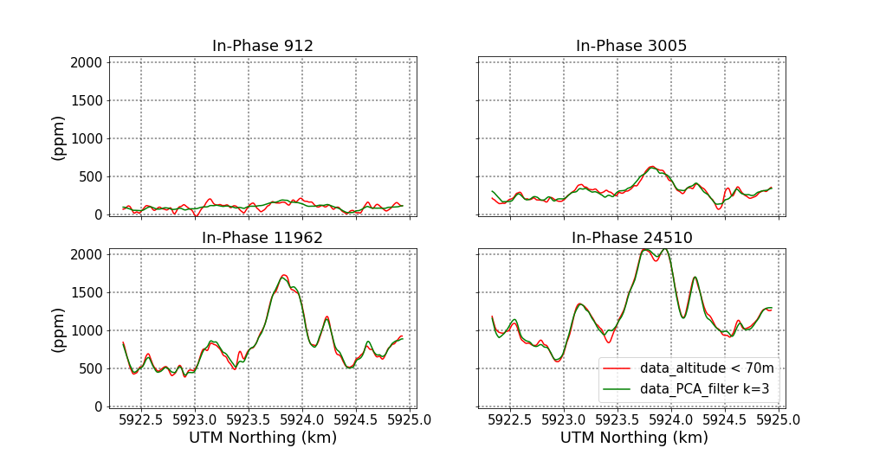
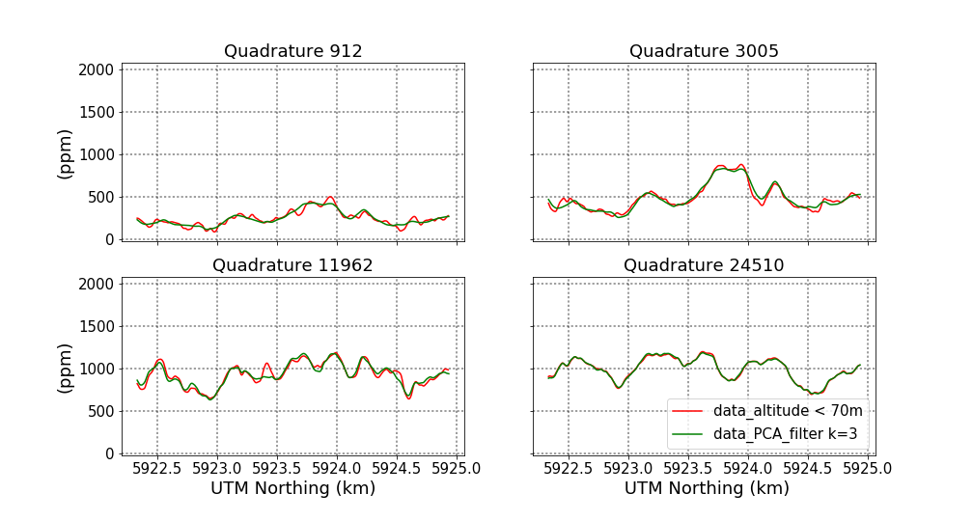
Data Pre-Processing
Remove High Fly data points: e.g., radar data > 70 m
PCA Analysis:
Flight Line: 1379

Slide 12
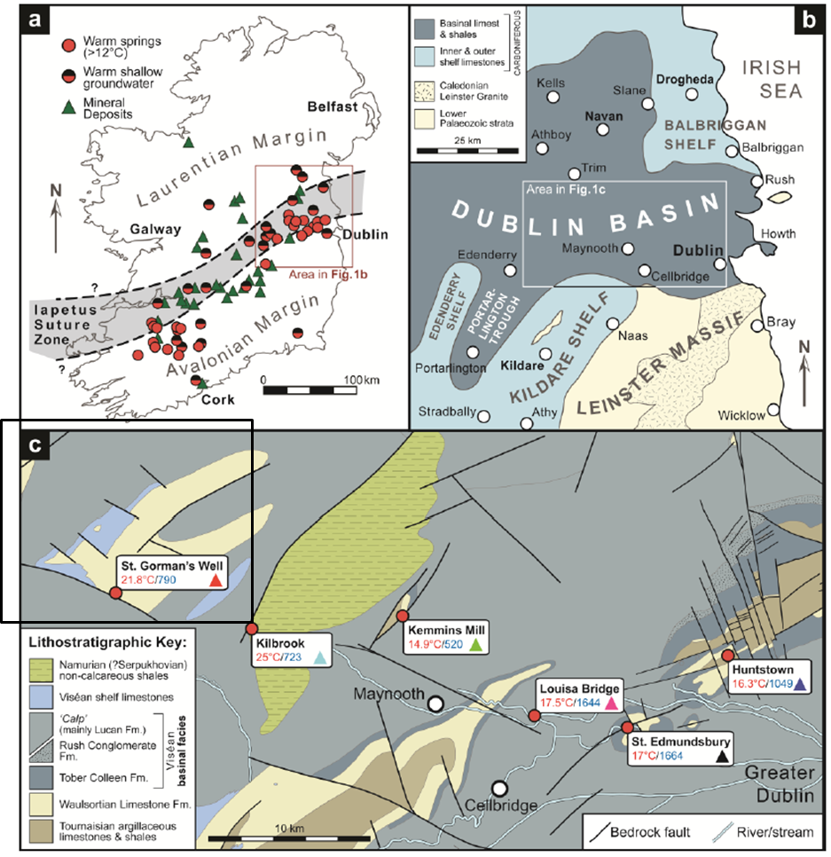
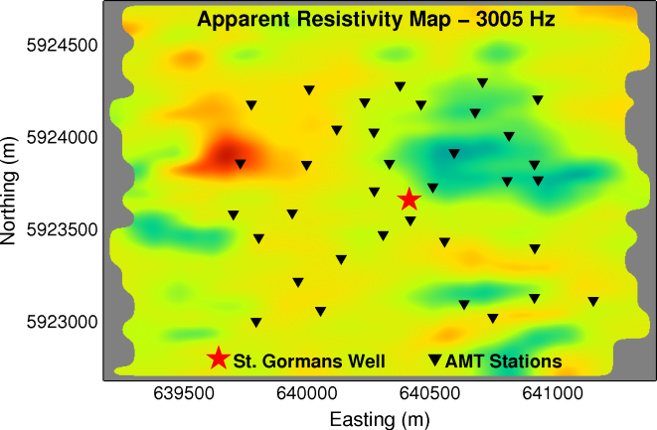
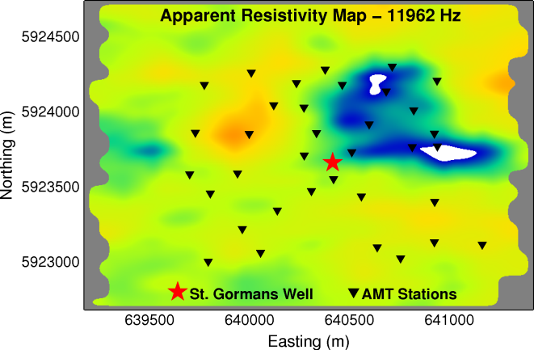
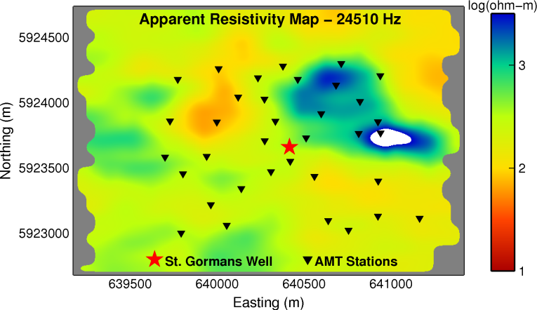
Field Data – Tellus A1 Block
Maps of Apparent Resistivity Data derived from
Tellus A1 Block AEM Data
(from Blake et al., 2016)

Slide 13
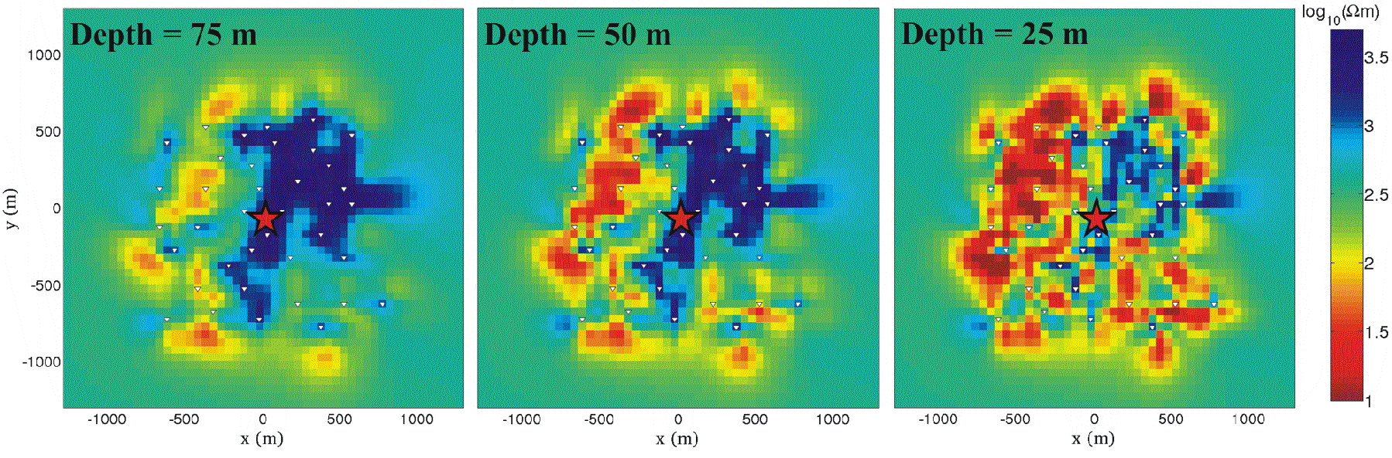
3-D High-Frequency Magnetotelluric Data
(after, Blake et al., 2016)

Slide 14
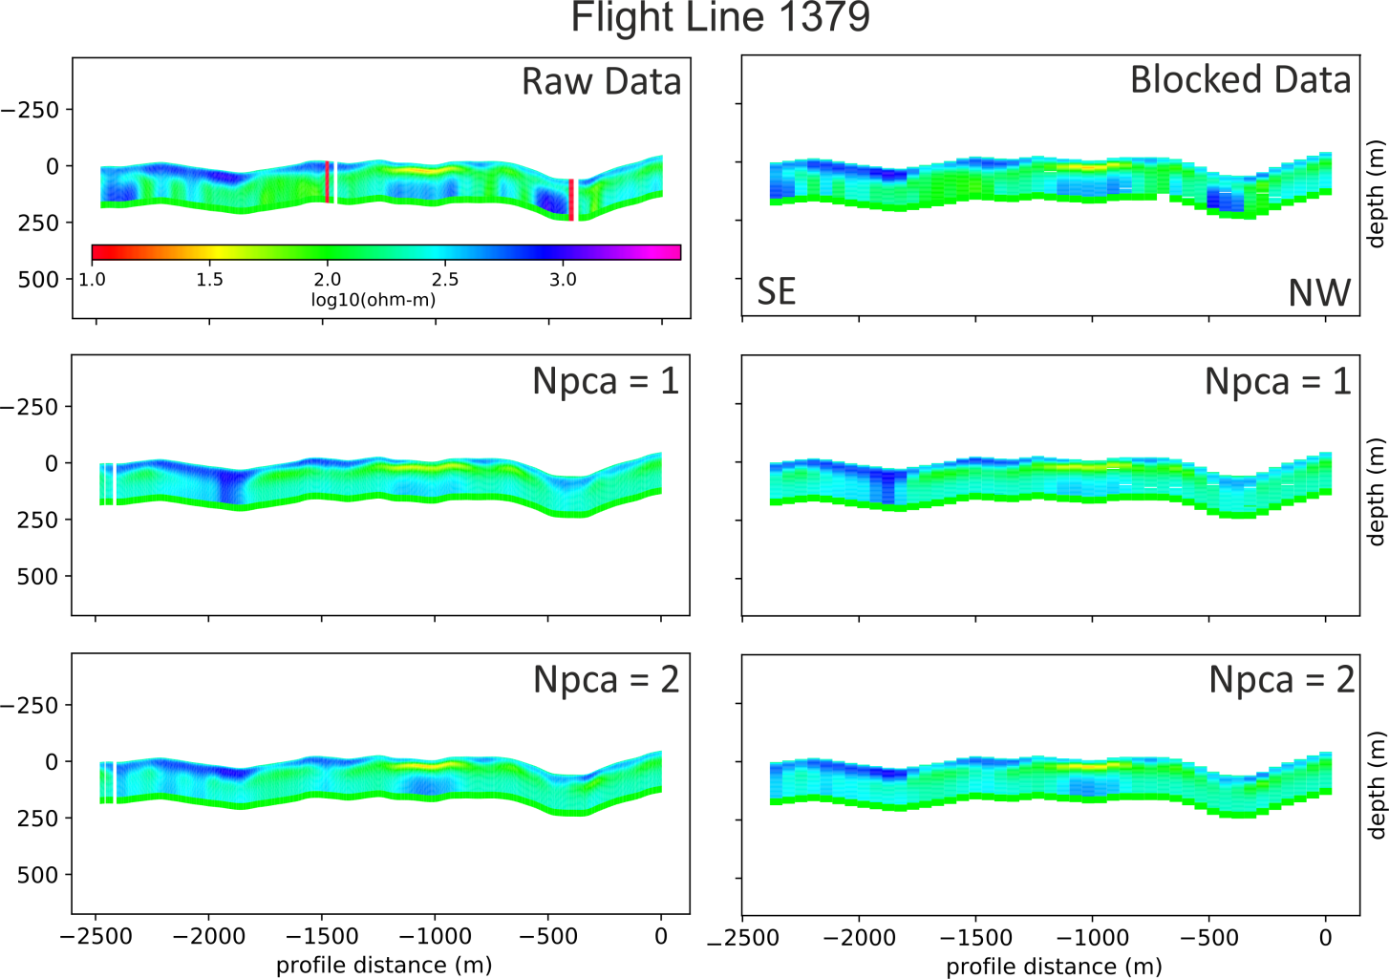
Data Inversion – Along Flight Lines
Tikhonov-type inversion results using raw data and blocked data of Tellus Block A1 Survey:
Block Data: data were summarised by their per-frequency arithmetic mean over 10 stations.
Inversion Parameters:
100 ohm-m randomly perturbed half-space model, 40 layers, with approx. 4m thick, fixed during the inversion

Slide 15
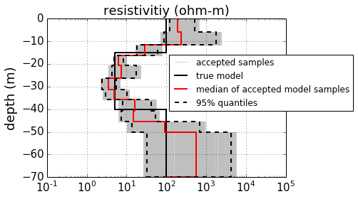
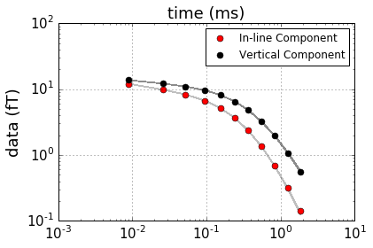
Bayesian MCMC – Synthetic Data
True Model:
Simulation Parameters Set-up:
100ohm-m
15m
Starting Model: 100 ohm-m, randomly perturbed
Number of layers: 12, approx. 5m thick, fixed
Assumed Data Error: 0.01
Number of samples: 100,000
5ohm-m
25m
100 ohm-m
Time-Domain AEM Results
A summary of the output from the Metropolis-Hastings algorithm

Slide 16
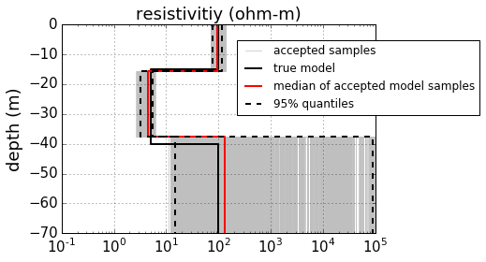
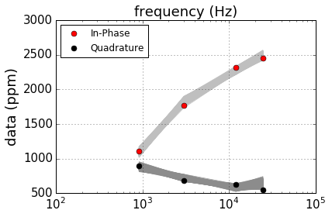
Bayesian MCMC – Synthetic Data
True Model:
Simulation Parameters Set-up:
100ohm-m
15m
Starting Model: 100 ohm-m, randomly perturbed
Number of layers: 3, approx. 40m thick, not fixed
Assumed Data Error: 30 ppm
Number of samples: 1,000,000
5ohm-m
25m
100 ohm-m
Frequency-Domain AEM Results
A summary of the output from the Metropolis-Hastings algorithm

Slide 17
Summary/Conclusions
State of the toolbox:
Free Python framework exists for processing and inversion of airborne time- and frequency –domain airborne EM
Numerous algorithms are implemented
Processing: imputation/interpolation of gaps, PCA analysis
Inversion: Tikhonov and MAP deterministic inversions, MCMC
On-going and Future Work:
Fill public repository with tested scripts
Case studies for real world data
Better error model
More systems (legacy GEOTEM data)
More algorithms for inversion
Deterministic (Sharp boundaries, image guided)
Stochastic (trans-dimensional, hybridisation)
From 1-D to 2(3)-D models
Work flows for large data sets (parallelism), in particular MCMC

Slide 18
Acknowledgements
DK was funded by the Geological Survey of Ireland (GSI) under the research grant sc2015-004. We would like to thank the GSI team, especially James A. Hodgson and Mohammednur Dessisa Ture, who were most helpful and co-operative, and thus contributed considerably to this work. Australia’s CSIRO and the AMIRA International consortium are thanked for making their P223 modelling suite open access.

Slide 19
References
Blake et al., 2016. Electromagnetic imaging of hydrothermal circulation systems beneath two
thermal springs in Ireland, presented at IRETHERM Workshop, April 1, 2016, Dublin, Ireland.
Hodgson, J.A. and Ture M.D., 2016. Tellus A1 Airborne Geophysical Survey Logistics, Processing
and Merging Report.
Lanczos, C., 1961. Linear differential Operators. D. Van Nostrand Co. Ltd.

Slide 20
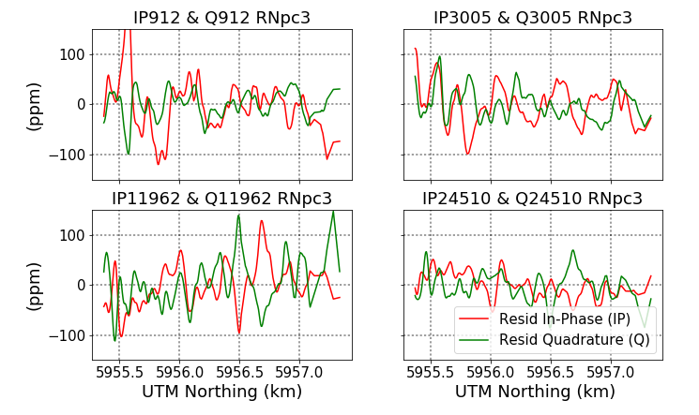
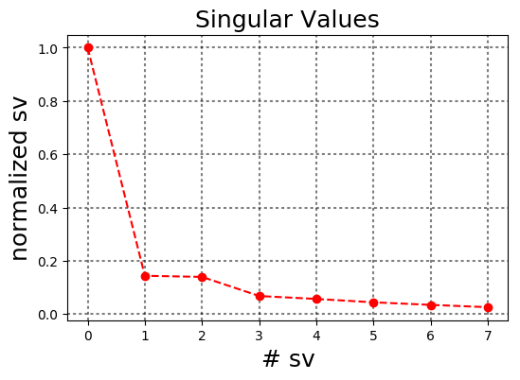
PCA Denoising Analysis:
Decomposition in principal components (PCA) is to reduce noise and impose regularity (consistence) on the data.
PCA approximation is based on the singular value decomposition (SVD, Lanczos, 1961).
→ n_{data} × n_{sites} Matrix of an observation, D, remove average and standardize
→ decompose: (U , V unitary, S diagonal, singular values)
→ choose k largest values and truncate to
→ Independent estimate of error (high-fly) indicate that k> 3 is probably “noise”
57/41 ppm
43/25 ppm
44/27 ppm
27/30 ppm

Slide 21
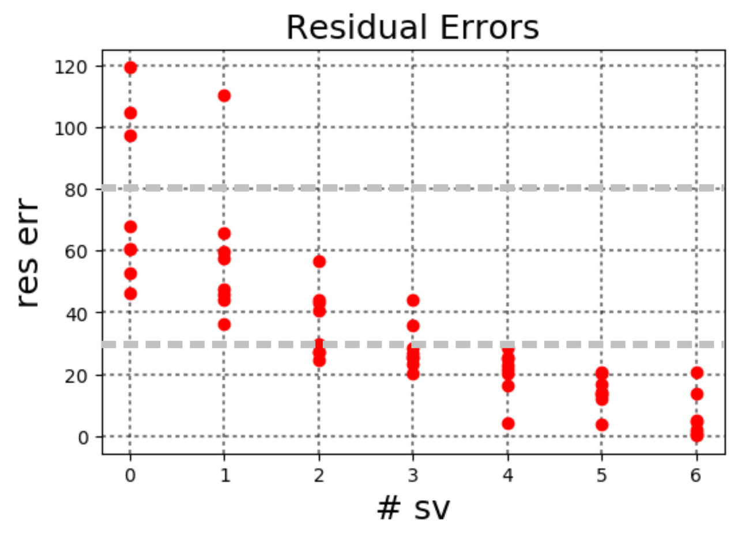
PCA Denoising Analysis
Why k ≤ 3?
Error limit from the high-fly areas
Error limit from the high-fly areas

Slide 22
“Deterministic” inversion
Examples
Tikhonov-type regularization (stabilize ill-posed problem)
MAP estimates derived from Bayesian theory
Produces only one optimal model, may be biased by choice of data fit and model constraints (smoothness, blockyness)
Fast, but usually needs derivatives (“Jacobian”, “sensitivity”)
Many variants (as Tikh and MAP) may be solved within the same computational framework
Optimization problem:

